Slide 1
Predicting Shipping On-time Performance
Winston Zhong

Slide 2
Table of Contents
Introduction
Data acquisition and wrangling
Exploratory data analysis
Baseline modeling
Extended modeling
Recommendations
Future work

Slide 3

Introduction
E-commerce company wants to improve shipping on-time performance
Developed classification model to predict whether a shipment will arrive on time or not
Use model to see which factors had the most effect on shipping performance

Slide 4
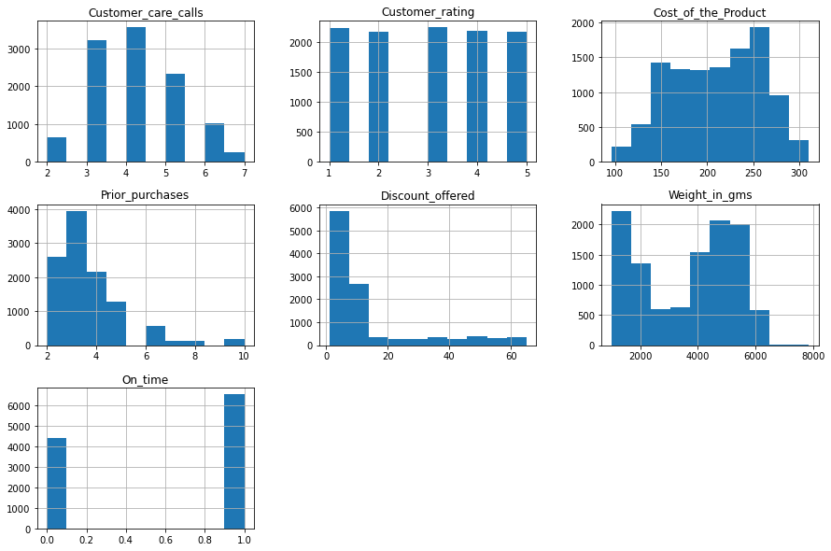
Data Acquisition and Wrangling
Data from Kaggle
Remove ID column, strip spaces, rename column name

Slide 5
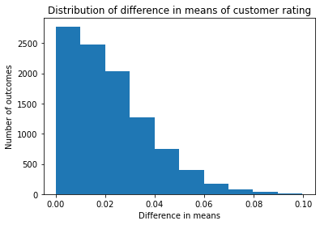
Exploratory Data Analysis
Overall on time rate: 40.33%
On time rate by ship mode:
Flight: 39.84%
Ship: 40.24%
Road: 41.19%
Average customer rating by result:
On time: 2.97
Late: 3.01
Permutation test showed that averages are not significantly different, p-value = 0.1657

Slide 6
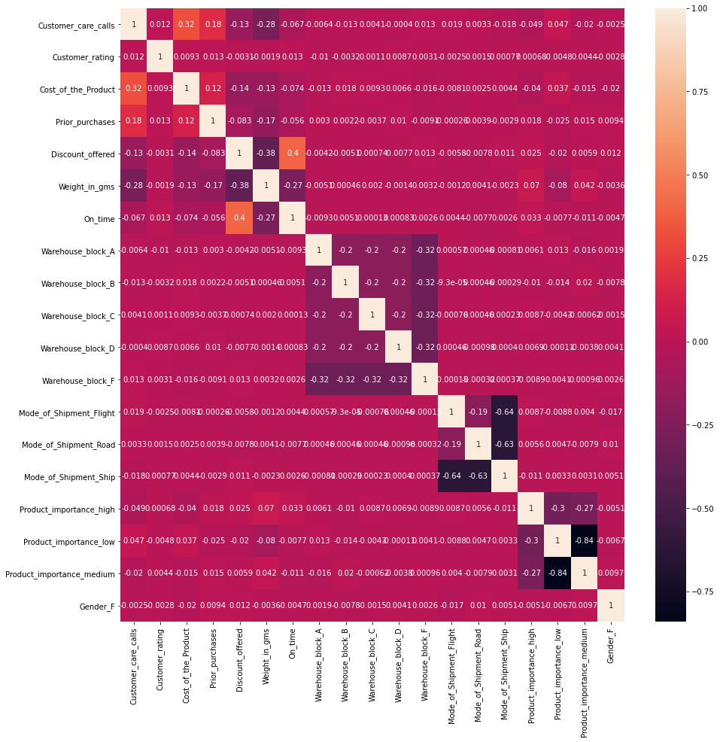
Heat Map After One-hot Encode

Slide 7
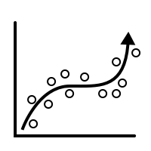
Baseline Modeling
Logistic regression, K-nearest neighbors, gradient boosting, and decision tree
Minimize false positives and maximize accuracy score and precision
Improve models by scaling data and hyperparameter tuning

Slide 8
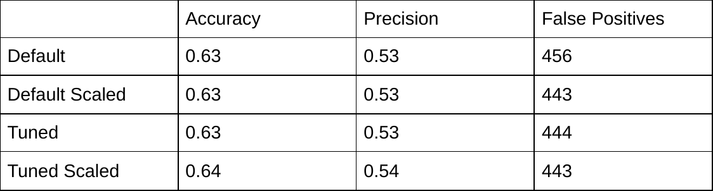
Logistic Regression

Slide 9
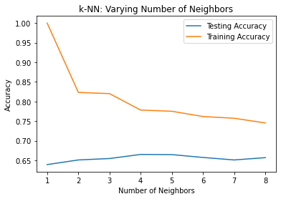
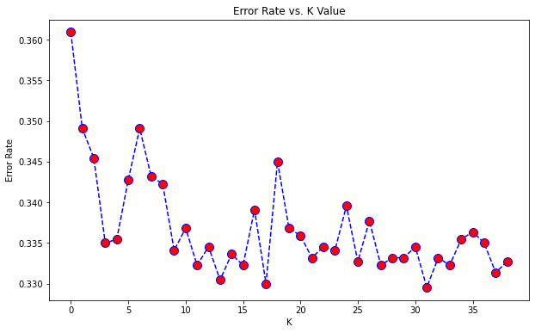
KNN

Slide 10
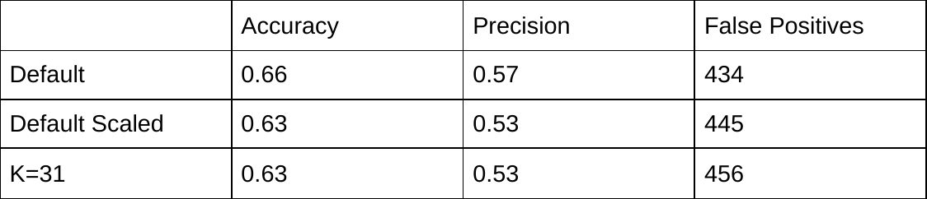
KNN

Slide 11
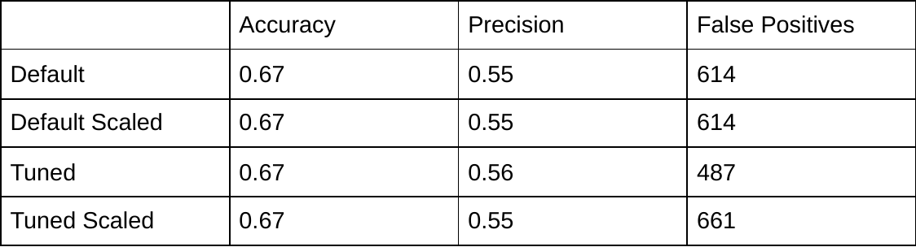
Gradient Boosting

Slide 12
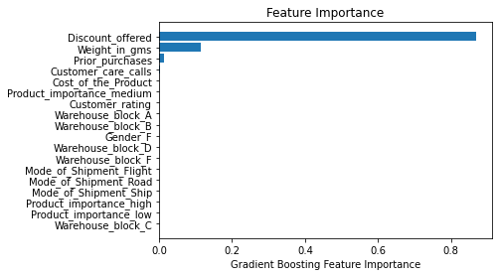
Gradient Boosting Feature Importance

Slide 13
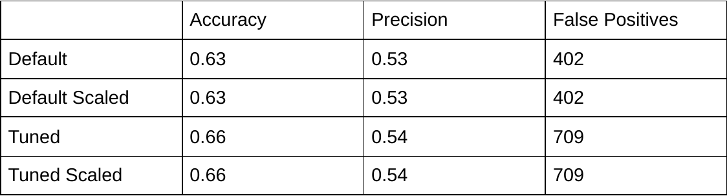
Decision Tree

Slide 14
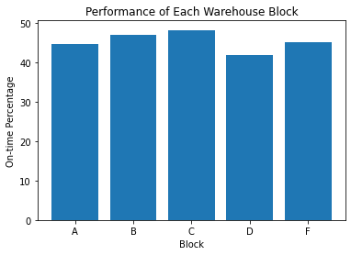
Recommendations
Move high importance shipments from warehouse block D to warehouse block C
20.51% of high importance late shipments not in block C were in block D

Slide 15
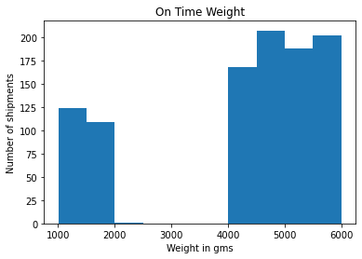
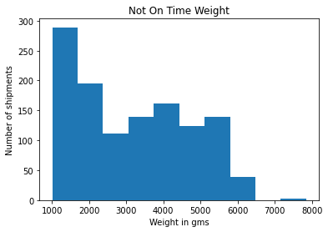
Recommendations
Shipping performance for products weighing between 2,000 grams and 4,000 grams need to be improved significantly

Slide 16
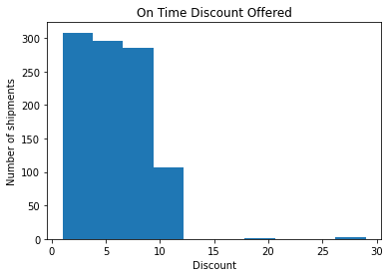
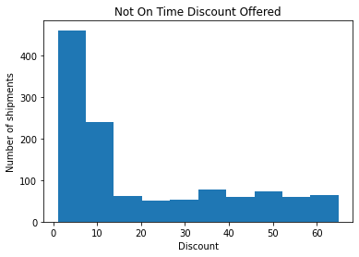
Recommendations
Improve shipping for discounts > 12%, especially for discounts > 30%

Slide 17

Future Work
More features like distance from origin to destination and types of products
Collect more data to see how changes affect on-time performance

